Slide 1
Welcome to Comp 411! Computer Organization and Design
Montek Singh
Jan 11, 2016
Lecture 1

Slide 2
Topics for today
Course Objectives
Course Mechanics
What is Information?
Computer Abstractions

Slide 3
Course Objectives
What You Will Learn:
How programs are translated into the machine language
And how the hardware executes them
The hardware/software interface
What determines program performance
And how it can be improved
What a typical computer processor looks like
How hardware designers improve performance

Slide 4
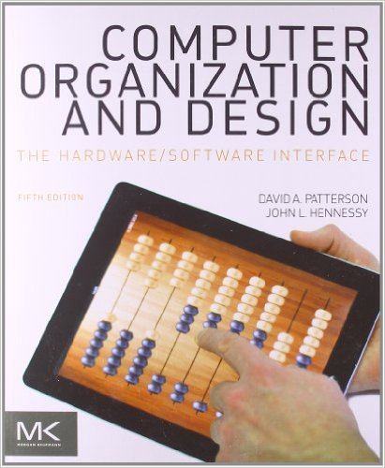
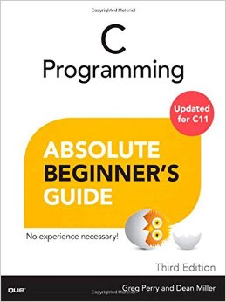
Required Textbooks
Computer Organization and Design: The Hardware/Software Interface
Patterson and Hennessy
5th ed., Oct 2013
ISBN 9780124077263
C Programming: Absolute Beginner’s Guide
Greg Perry and Dean Miller
3rd ed., Aug 2013 ISBN 978-0789751980

Slide 5
Credits
Some of these slides were developed by Leonard McMillan and adapted by Gary Bishop and me.
Some slides and other materials are from the book publisher.

Slide 6
Course Mechanics
Grading:
Homework: 25%
Lab Assignments: 25%
Quizzes: 15%
Midterm: 15%
Final Exam: 20%

Slide 7
Course Mechanics
Policies:
Problem Sets:
Will be distributed on the web. You will typically have 1 week to do them, but sometimes more or less time.
Honor Code:
The honor code is in effect for all homework, labs, exams etc. Please review the policy on the course website.
Lecture Notes:
I will attempt to make Lecture Slides, Problem Sets, and other course materials available on the web either before class, or soon after, on the day they are given.

Slide 8
Course Policies
Late homework/labs will NOT be accepted
No exceptions for foreseeable events:
Religious/cultural holidays
Family reunions
Most athletic/club commitments
Plan ahead!
No exceptions for:
out-of-town trips, job interviews, computer crashes, mild sickness, etc.
For serious medical or other issues etc.
Will need proof and permission from somebody higher up
Lowest scores dropped
2 lowest lab scores dropped
but scores for “lab project” not dropped
1 lowest homework score dropped
1 lowest quiz score dropped

Slide 9
Course Policies
Quizzes and Exams are open-book
open-book, open-notes, calculator allowed, access to class website allowed
Missed classes, quizzes, exam conflicts
classes: while attendance is not required, there is no substitute to coming to class if you want a good grade
labs: skipping a lab (even if you have a good excuse) will make it very hard to complete the lab
quizzes: since the dates are announced, please see me well in advance if you have a compelling reason for absence
exams: bring any conflicts to my attention ASAP

Slide 10
Discussion Board
Please post questions (even private ones to instructor) on the discussion board on PIAZZA
https://piazza.com/unc/spring2016/comp411
Linked from course website

Slide 11
Honor Code
Collaboration:
Allowed (even encouraged) to discuss basic concepts
use discussion board on Piazza
bonus points for active participation!
BUT: What you hand in must be your own
write solutions and code individually
Previous Semesters:
Cannot use homework solutions from previous offerings of this course
Cannot obtain lab assignments/code from students who have taken this course before
Not following these rules is a violation of honor code

Slide 12
Prerequisites
COMP401: Foundations of Programming
This is a hard prerequisite
You may be able to substitute another programming course, but please first talk to me!
You need to know at least the following concepts:
basic data types: integers, characters, Boolean, etc.
basic arithmetic operators and expressions
“if-then-else” constructs, and “while”/“for” loops
function and procedure calls
basic Boolean operators (AND, OR, XOR, etc.)
If you don’t know many of the above concepts, please talk to me!

Slide 13
Detailed Syllabus / Course Website
See course website:
https://comp411spring16.web.unc.edu
Linked from my home page:
http://www.cs.unc.edu/~montek/

Slide 14
How NOT to do well in this course
BIG mistakes
Skipping lectures
Not reading the book (only reviewing lecture slides)
Not spending enough time to do homework
Start early. Many problem sets are too hard to attempt the night before.
Not asking questions in class
Not discussing concepts with other students
But all work handed in must be your own (see Honor Code)
Looking up solutions from earlier semesters = cheating. Not worth it.

Slide 15
Introductions
Who am I?
Who are you?
by year
by major
Why take this course?
let’s hear from you

Slide 16
Goal 1: Demystify Computers
Strangely, most people (even some computer scientists) are afraid of computers.
We are only afraid of things we do not understand!
I do not fear computers. I fear the lack of them.
- Isaac Asimov (1920 – 1992)
Fear is the main source of superstition, and one of the main sources of cruelty. To conquer fear is the beginning of wisdom.
- Bertrand Russell (1872 – 1970)

Slide 17
Where do you find computers today?
Besides on your desk, or in your lap, of course!
Let’s hear from you!
How have computers revolutionized life in the 21st century?
Automobiles
Mobile phones, PDAs, games
Massive distributed projects: e.g., human genome project
World Wide Web
Search engines
What has fueled progress in computer technology?
Moore’s Law

Slide 18
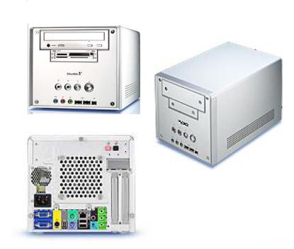
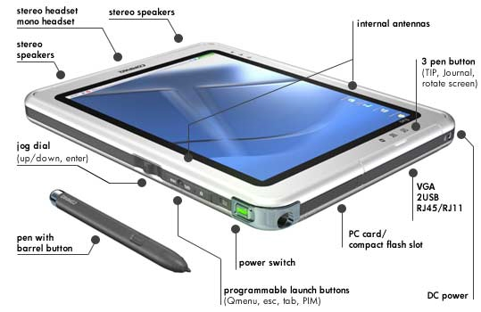
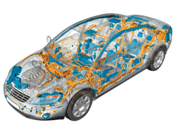
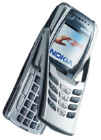
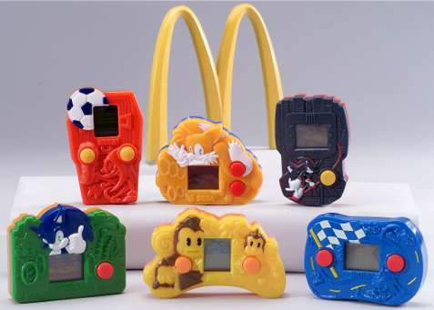
Computers Everywhere
The computers we are used to
Desktops
Laptops
Servers
Network-based
“Cloud computers”
Embedded processors
Hidden as components inside: cars, phones, toasters, irons, wristwatches, happy-meal toys

Slide 19
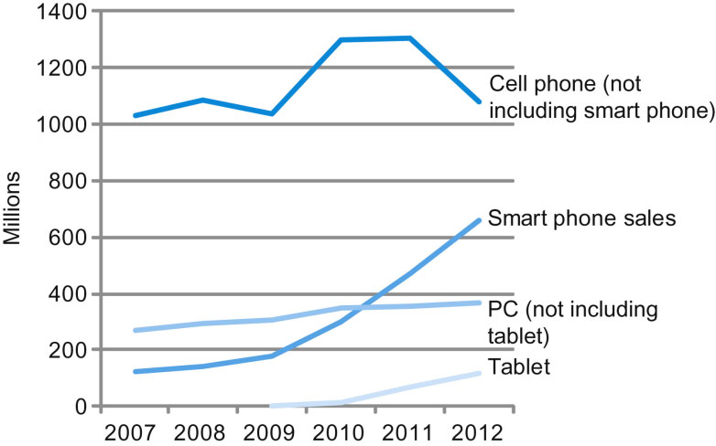
Portable gadgets dominate!
FIGURE 1.2 The number manufactured per year of tablets and smart phones, which reflect the PostPC era, versus personal computers and traditional cell phones. Smart phones represent the recent growth in the cell phone industry, and they passed PCs in 2011. Tablets are the fastest growing category, nearly doubling between 2011 and 2012. Recent PCs and traditional cell phone categories are relatively flat or declining.

Slide 20
Goal 2: Power of Abstraction
What is abstraction?
Define a function, develop a robust implementation, and then put a box around it.
Why is abstraction useful?
enables us to create unfathomable machines called computers
imagine a billion --- 1,000,000,000

Slide 21
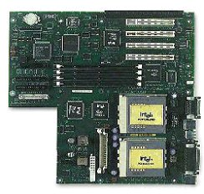
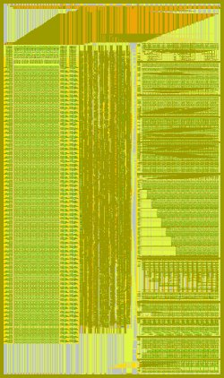
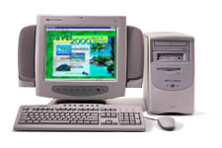
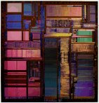
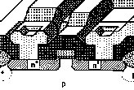

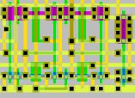

Abstraction is key to building systems with >1G components
Personal Computer:
Hardware & Software
Circuit Board:
≈8 / system
1-2G devices
Integrated Circuit:
≈8-16 / PCB
0.25M-16M devices
Module:
≈8-16 / IC
100K devices
MOSFET
="transistor"
="device"
Scheme for
representing
information
Cell:
≈1K-10K / Module
16-64 devices
Gate:
≈2-8 / Cell
8 devices

Slide 22
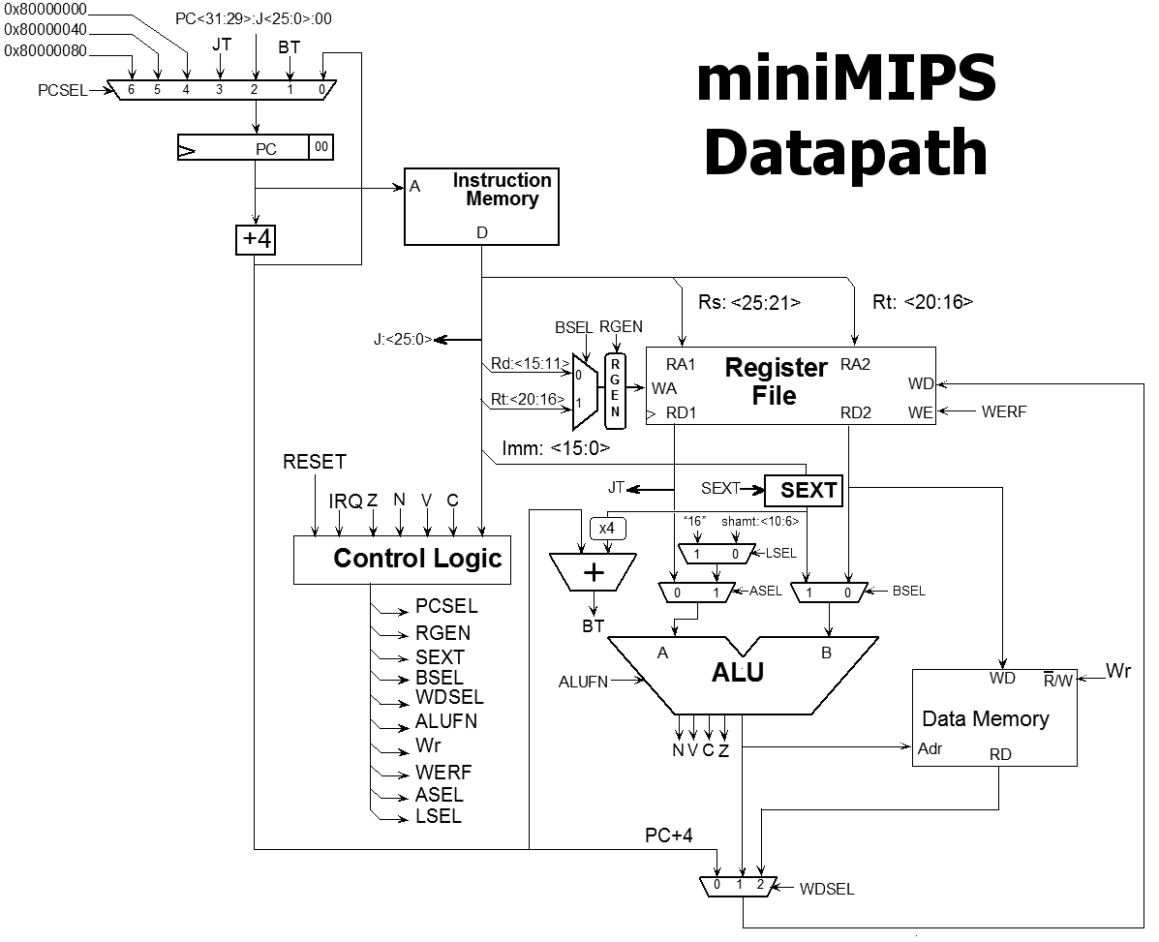
A Computer System
What is a computer system?
Where does it start?
Where does it end?
for (i = 0; i < 3; i++)
m += i*i;
Compiler
Assembler and Linker
addi $8, $6, $6
sll $8, $8, 4
CPU
Module
A
ALU
B
A B
CO CI
S
Cells
FA
Gates
Transistors
Notes:
Order of a computer system.
Transistors make gates, make cells etc.
Important portion is programming. CPU speaks it’s own language and this is a basic set of instructions.
Compiler is a nice high level language to make programming easier.

Slide 23
Understanding Performance
Algorithm
Determines number of operations executed
Programming language, compiler, architecture
Determine number of machine instructions executed per operation
Processor and memory system
Determine how fast instructions are executed
I/O system (including OS)
Determines how fast I/O operations are executed
Notes:
Algorithm you choose determines efficiency.
Higher up you go in language abstraction, your code gets more concise but it ends in a large number of instructions.
Processor and memory system read/execution is a large portion of impact on performance.
Input is how you get information into a computer, output is how to get it out.

Slide 24
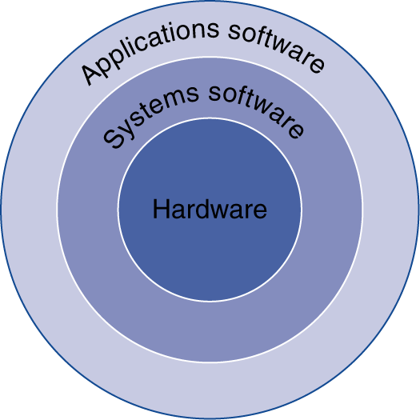
Below Your Program
Application software
Written in high-level language
System software
Compiler: translates HLL code to machine code
Operating System: service code
Handling input/output
Managing memory and storage
Scheduling tasks & sharing resources
Hardware
Processor, memory, I/O controllers

Slide 25
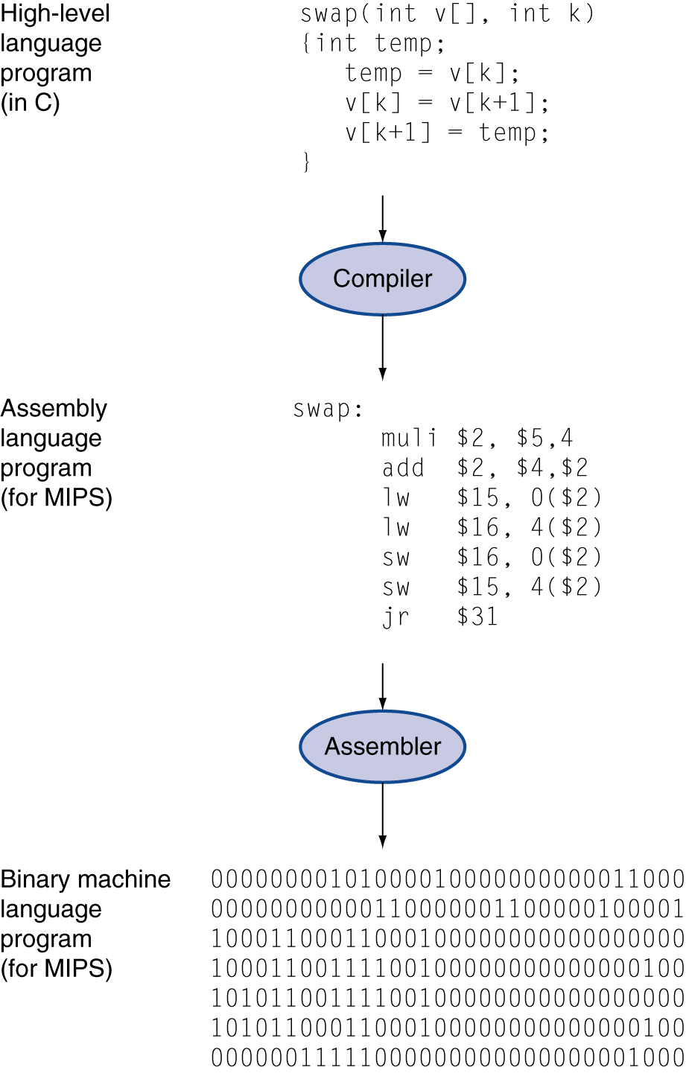
Levels of Program Code
High-level language
Level of abstraction closer to problem domain
Provides for productivity and portability
Assembly language
Textual representation of instructions
Hardware representation
Binary digits (bits)
Encoded instructions and data

Slide 26
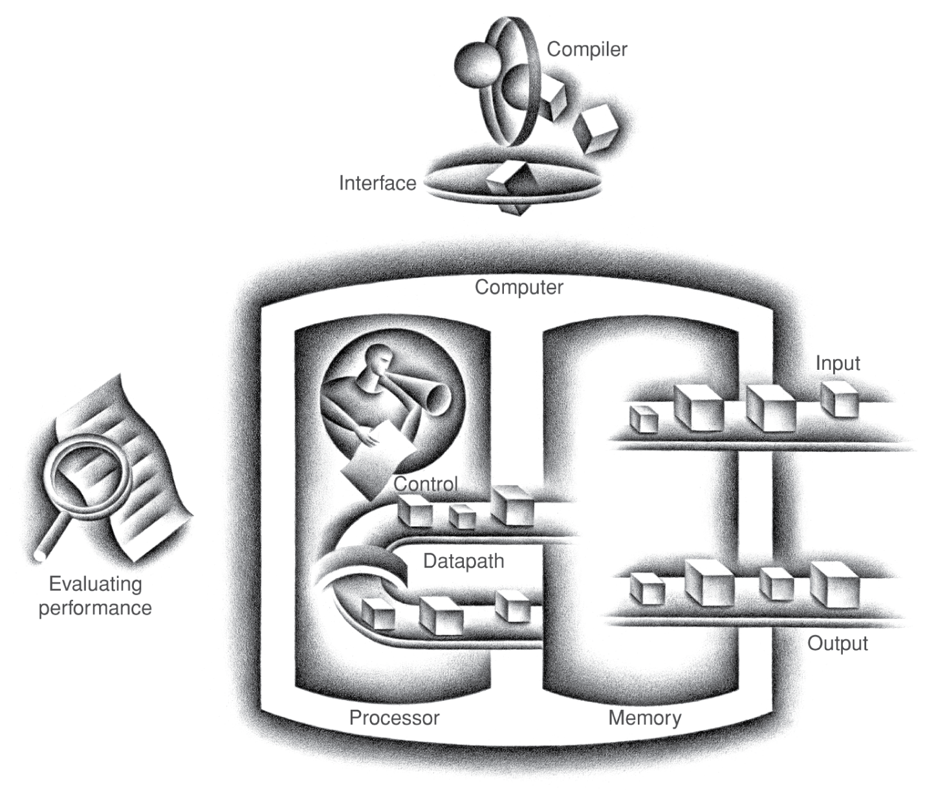
Components of a Computer
Same components for all kinds of computer
Desktop, server, embedded
Input/output includes
User-interface devices
Display, keyboard, mouse
Storage devices
Hard disk, CD/DVD, flash
Network adapters
For communicating with other computers
The BIG Picture

Slide 27
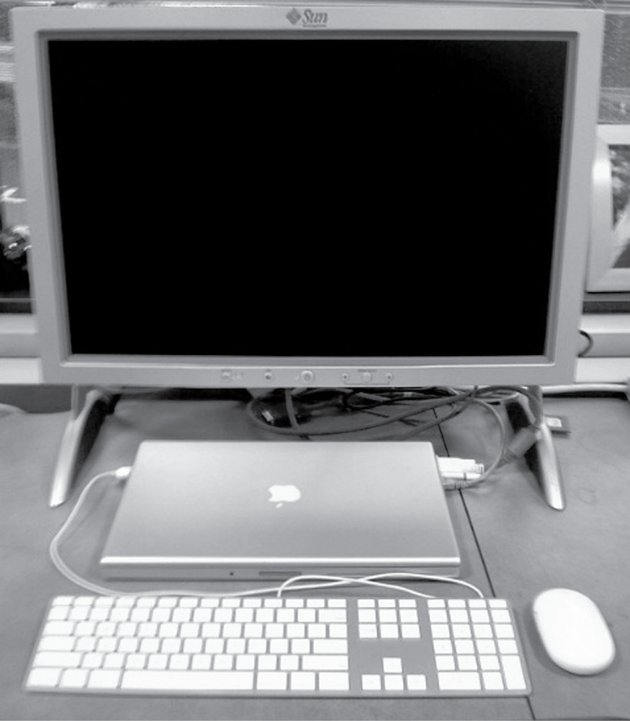
Anatomy of a Computer
Example: Laptop as today’s desktop
Output device
Network cable (I/O)
Input device
Input device
FIGURE 1.5 A desktop computer. The liquid crystal display (LCD) screen is the primary output device, and the keyboard and mouse are the primary input devices. On the right side is an Ethernet cable that connected the laptop to the network and the Web. The lap top contains the processor, memory, and additional I/O devices. This system is a Macbook Pro 15" laptop connected to an external display. Copyright © 2009 Elsevier, Inc. All rights reserved.

Slide 28
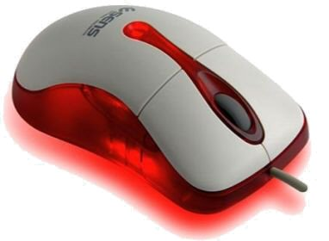
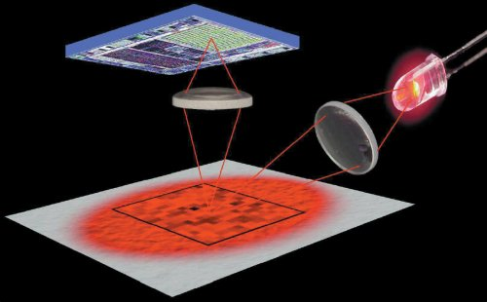
Anatomy of a Mouse
Optical mouse
LED illuminates desktop
Small low-res camera
Basic image processor
Looks for x, y movement
Buttons & wheel
Supersedes roller-ball mechanical mouse

Slide 29
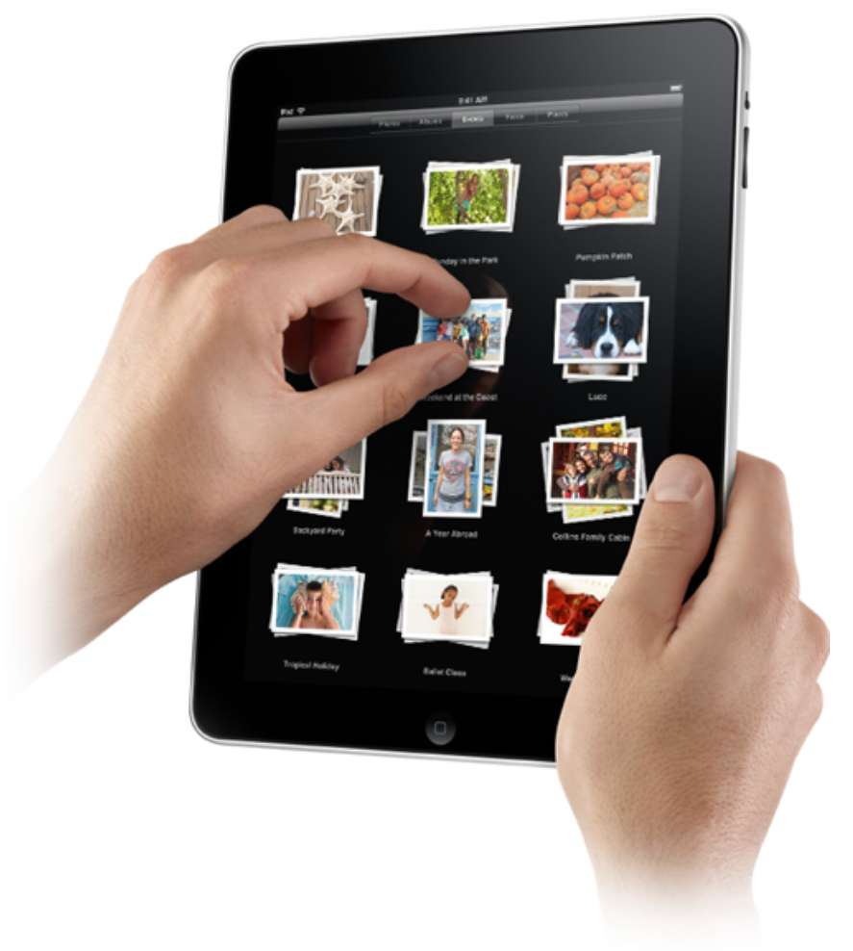
Touchscreen
PostPC device
Supersedes keyboard and mouse
Resistive and Capacitive types
Most tablets, smart phones use capacitive
Capacitive allows multiple touches simultaneously

Slide 30
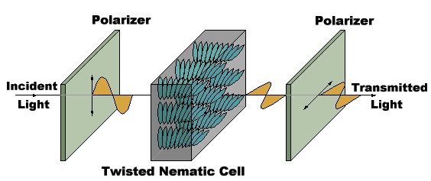
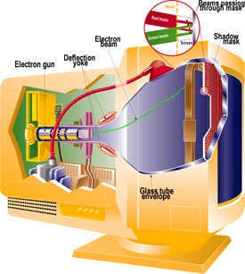
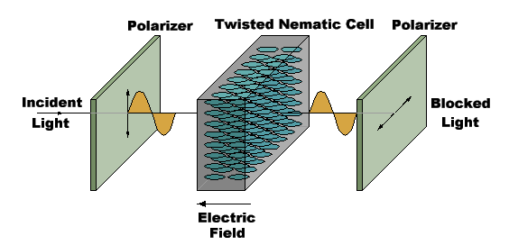
Displays
Cathode Ray Tube (CRT)
The “last vacuum tube”
Now nearing extinction
Liquid Crystal Displays (LCDs)

Slide 31
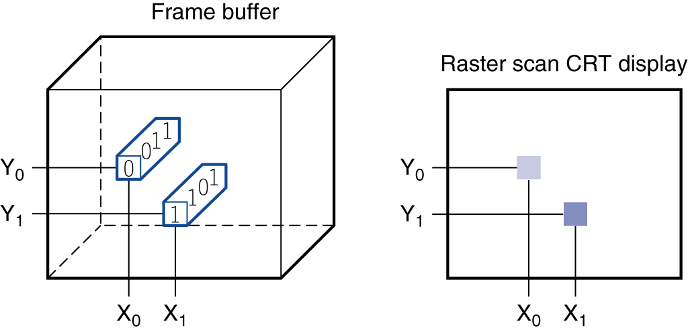
Display Abstraction
Screen: picture elements (pixels)
Mirrors content of “frame buffer” memory
FIGURE 1.6 Each coordinate in the frame buffer on the left determines the shade of the corresponding coordinate for the raster scan CRT display on the right. Pixel (X₀, Y₀) contains the bit pattern 0011, which is a lighter shade on the screen than the bit pattern 1101 in pixel (X₁, Y₁).

Slide 32
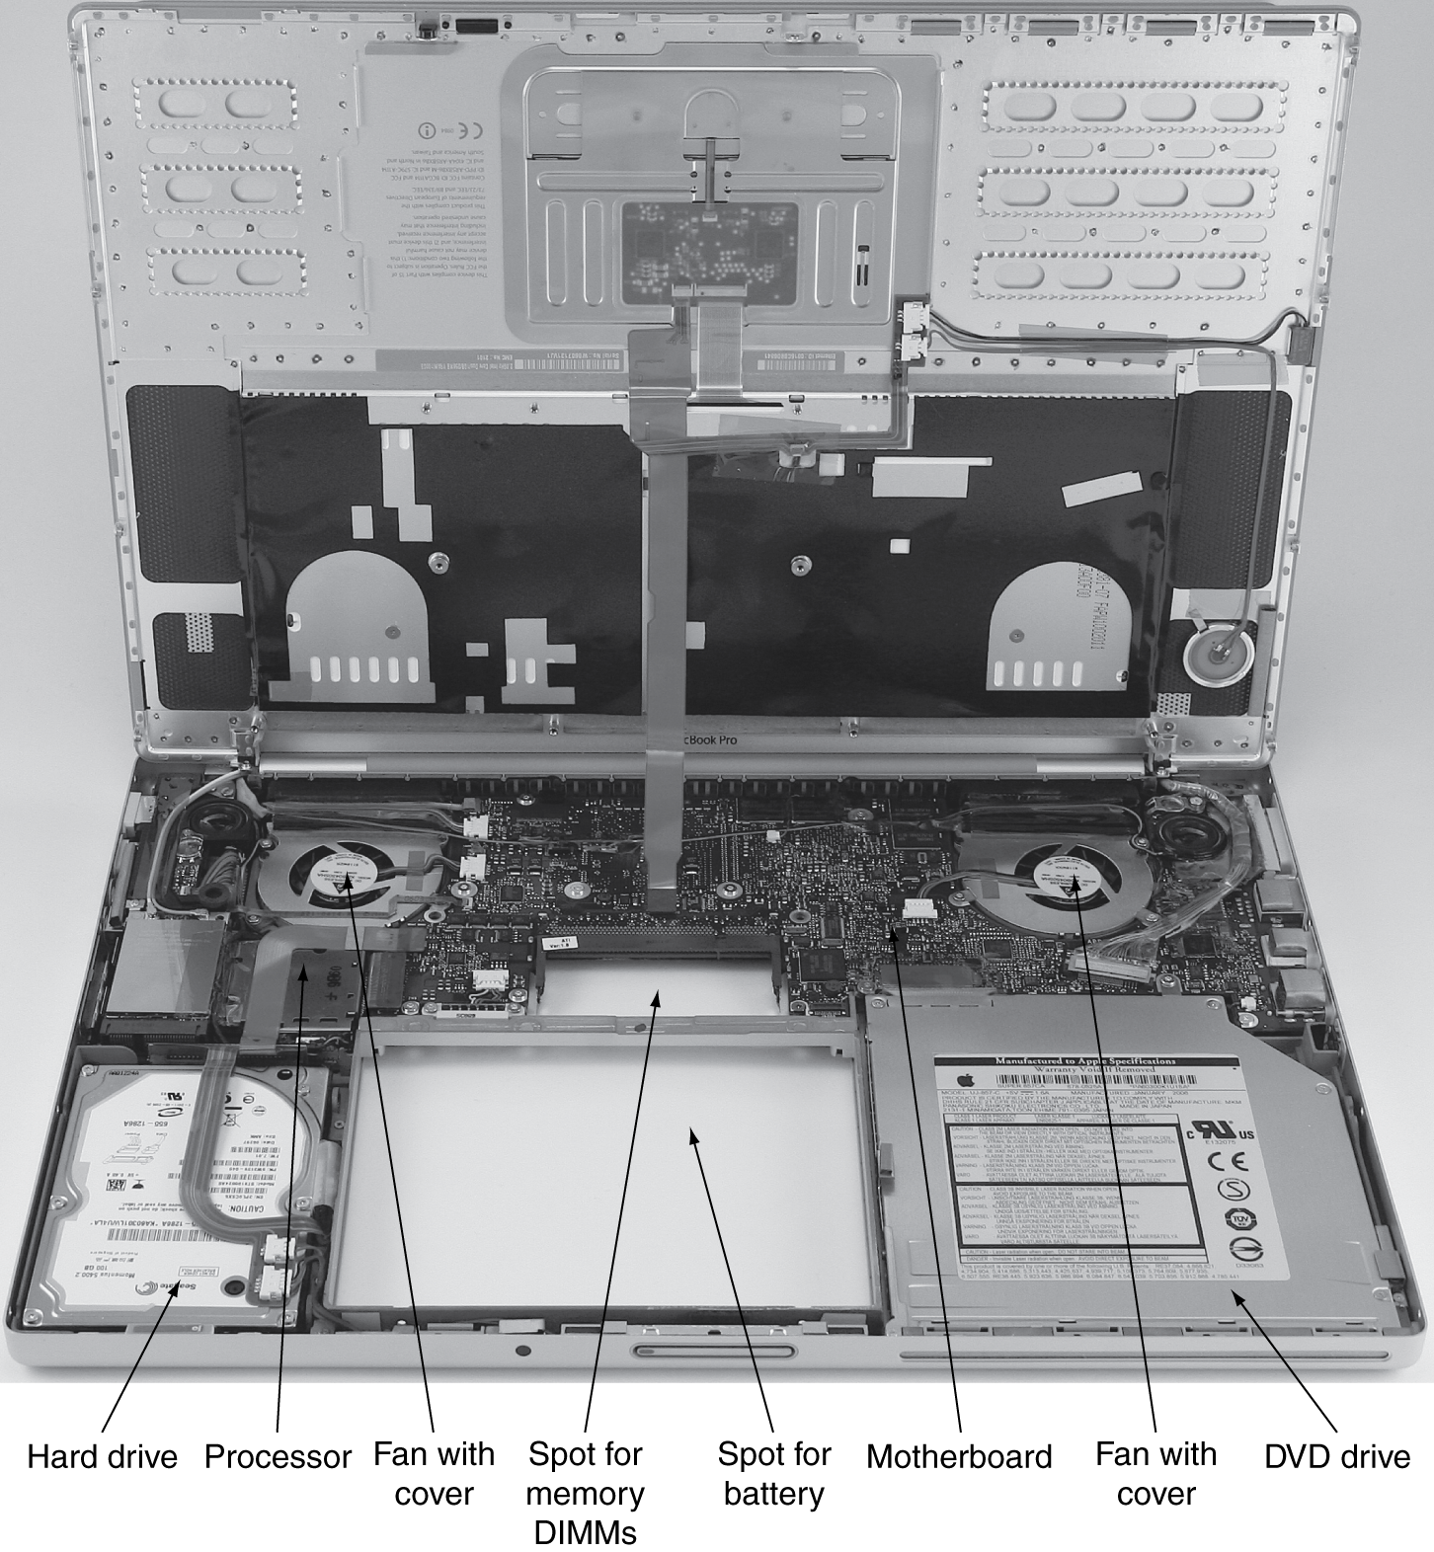
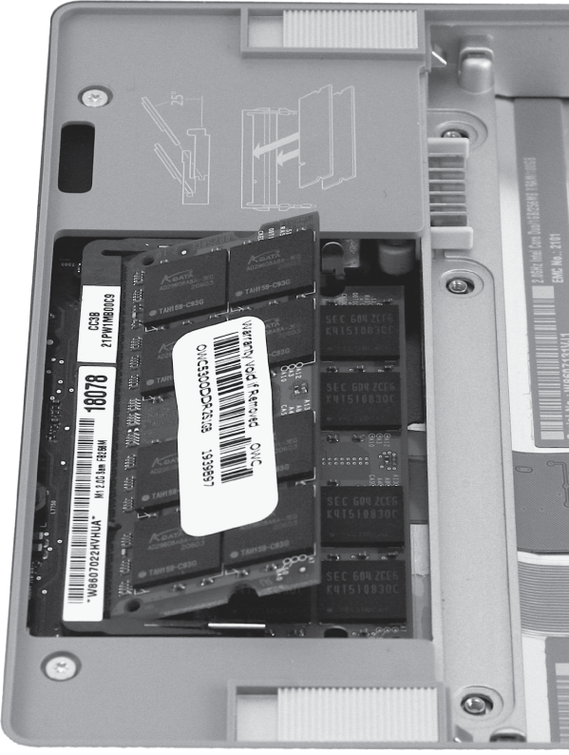
Opening the Box: Laptop

Slide 33
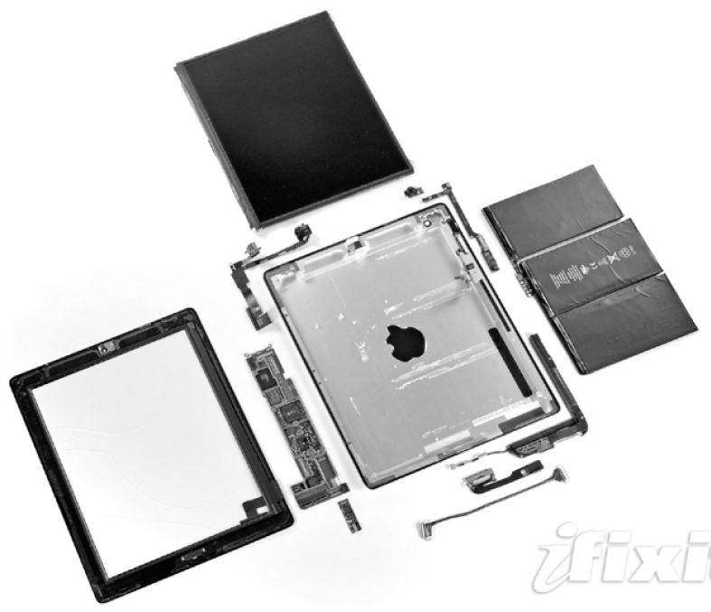
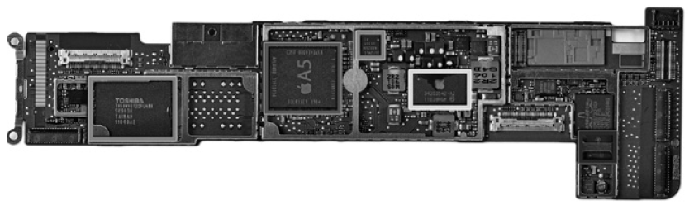
Opening the Box: Tablet
Capacitive multitouch LCD screen
3.8 V, 25 Watt-hour battery
Computer board

Slide 34
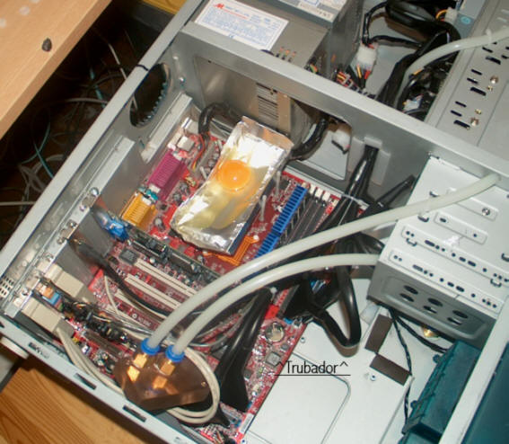
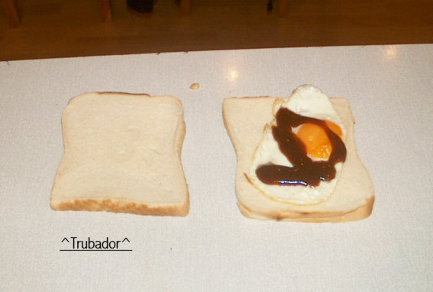
Issues for Modern Computers
Energy/Power consumption has become a major challenge
It is now perhaps the limiting factor in most processors
http://www.hotchips.org/
Courtesy Troubador

Slide 35
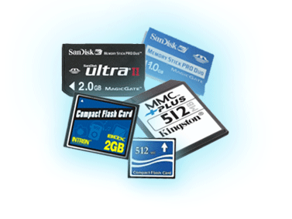
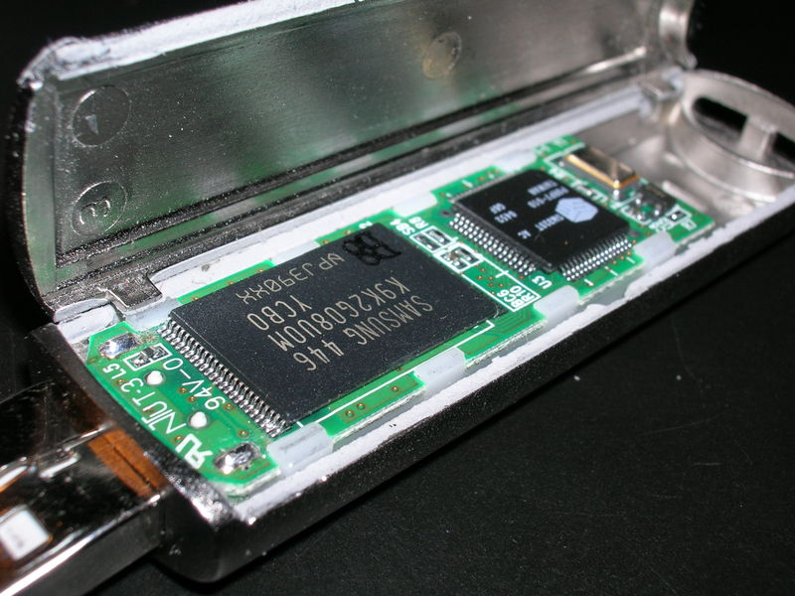
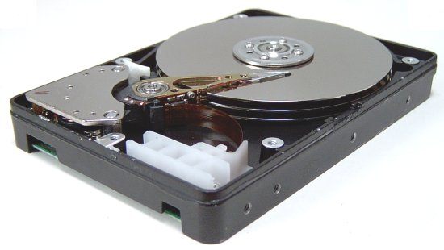
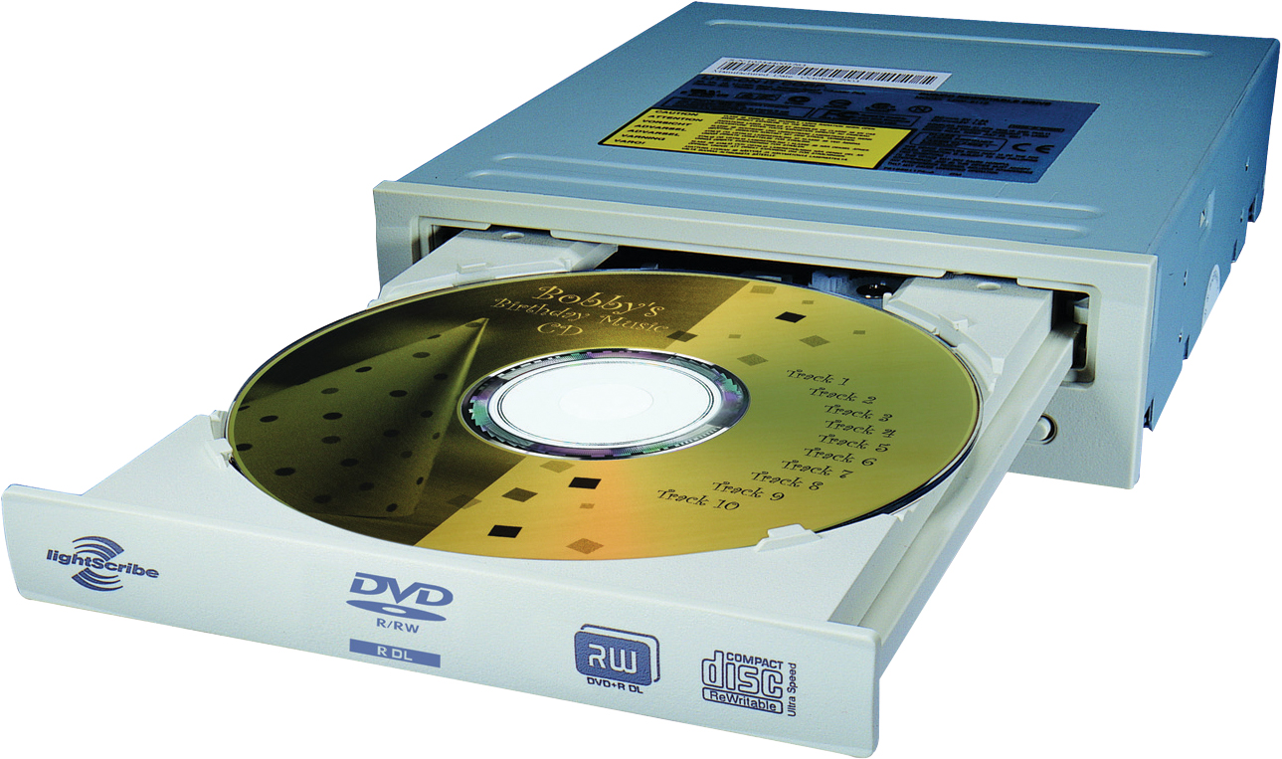
A Safe Place for Data
Volatile main memory
Loses instructions and data when power off
Non-volatile secondary memory
Magnetic disk
Flash memory
Optical disk (CDROM, DVD)

Slide 36
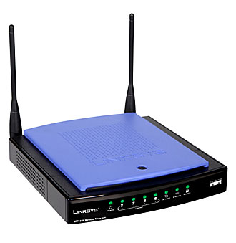
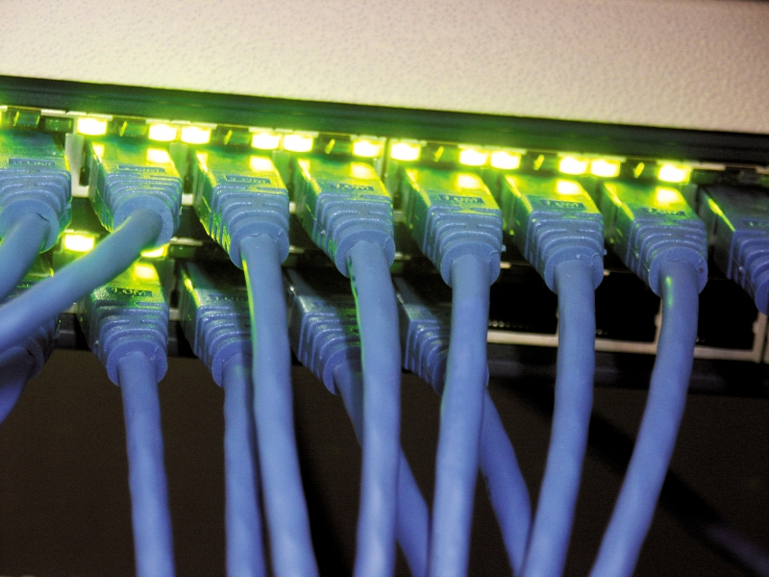
Networks
Communication and resource sharing
Local area network (LAN): Ethernet
Within a building
Wide area network (WAN): the Internet
Wireless network: WiFi, Bluetooth

Slide 37
Technology Trends
Electronics technology continues to evolve
Increased capacity and performance
Reduced cost
Year | Technology | Relative performance/cost
1951 | Vacuum tube | 1
1965 | Transistor | 35
1975 | Integrated circuit (IC) | 900
1995 | Very large scale IC (VLSI) | 2,400,000
2013 | Ultra large scale IC | 250,000,000,000

Slide 38
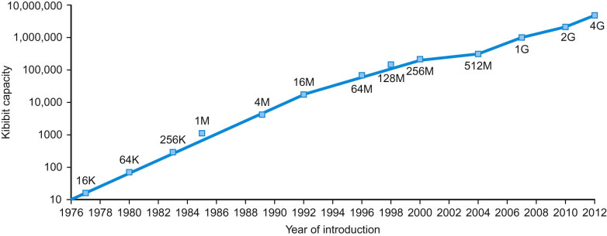
Technology Trends
Memory Capacity:
Growing exponentially as well
FIGURE 1.11 Growth of capacity per DRAM chip over time. The y-axis is measured in kibibits (2¹⁰ bits). The DRAM industry quadrupled capacity almost every three years, a 60% increase per year, for 20 years. In recent years, the rate has slowed down and is somewhat closer to doubling every two years to three years.

Slide 39
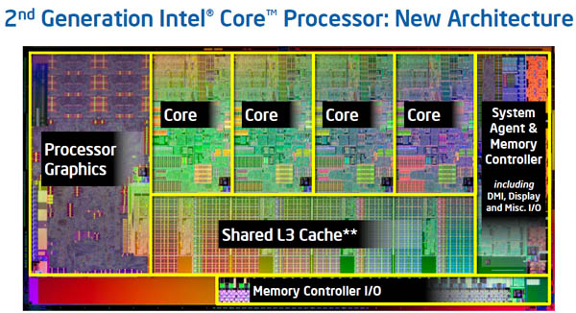
Inside the Processor: Intel Core i7
4 “cores”
each core is essentially an independent computing engine
at the top-level, memory and I/O is shared by all cores

Slide 40
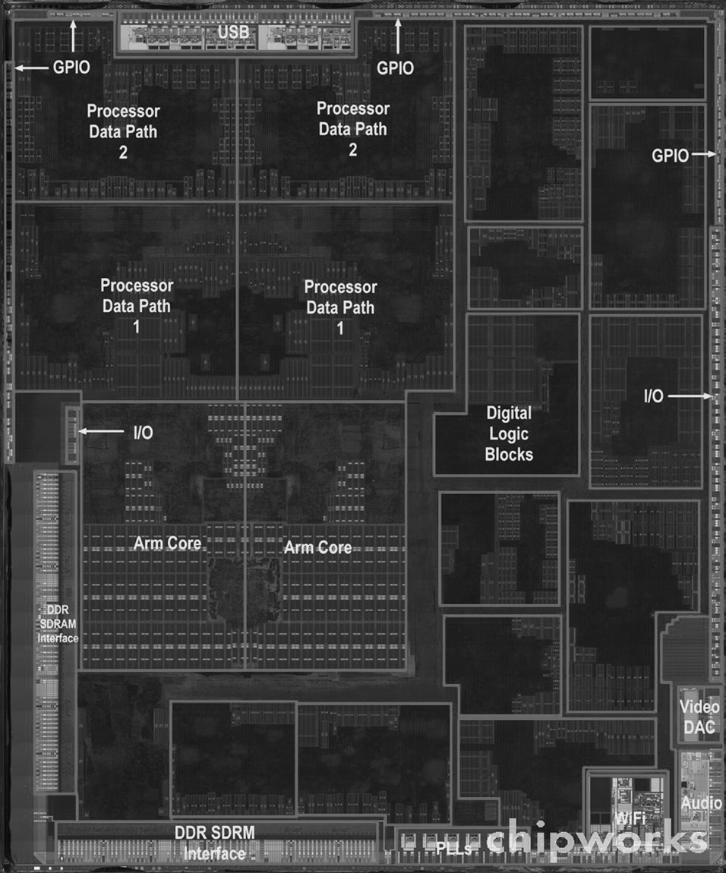
Inside the Processor: Apple
Apple A5
FIGURE 1.9 The processor integrated circuit inside the A5 package. The size of chip is 12.1 by 10.1 mm, and it was manufactured originally in a 45-nm process (see Section 1.5). It has two identical ARM processors or cores in the middle left of the chip and a PowerVR graphical processor unit (GPU) with four datapaths in the upper left quadrant. To the left and bottom side of the ARM cores are interfaces to main memory (DRAM). (Courtesy Chipworks, www.chipworks.com)

Slide 41
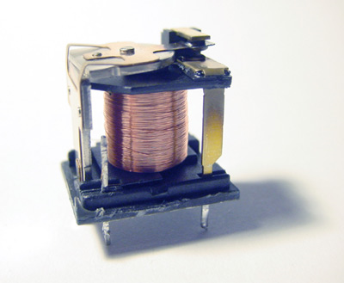
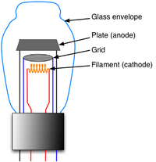
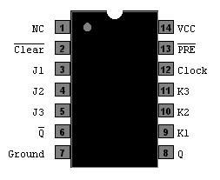
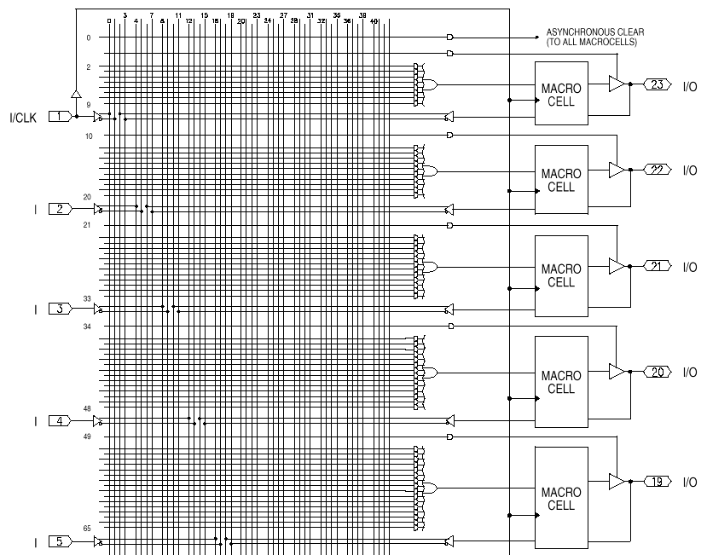
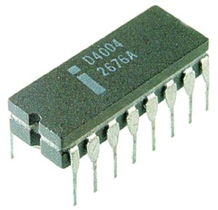
Implementation Technology
Relays
Vacuum Tubes
Transistors
Integrated Circuits
Gate-level integration
Medium Scale Integration (PALs)
Large Scale Integration (Processing unit on a chip)
Today (Multiple CPUs on a chip)
Nanotubes??
Quantum-Effect Devices??

Slide 42
Implementation Technology
Common Links?
A controllable switch
Computers are wires and switches
open
open
closed
control

Slide 43
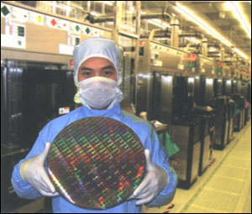
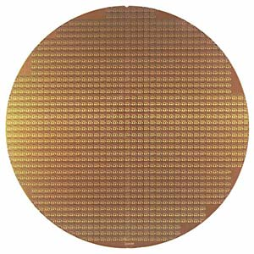
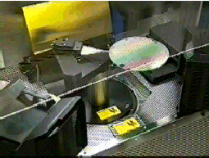
Chips
Silicon Wafers
Chip manufactures build many copies of the same circuit onto a single wafer.
Only a certain percentage of the chips will work; those that work will run at different speeds. The yield decreases as the size of the chips increases and the feature size decreases.
Wafers are processed by automated fabrication lines.
To minimize the chance of contaminants ruining a process step, great care is taken to maintain a meticulously clean environment.

Slide 44
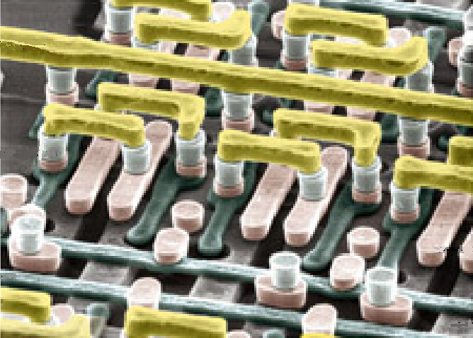
Chips
Silicon Wafers
IBM photomicrograph
Metal 2
M1/M2 via
Metal 1
Polysilicon
Diffusion
Mosfet (under polysilicon gate)

Slide 45
Next Lecture
Computer Performance
How to measure performance
How to compare performance
First Lab: Fri, Jan 15

